Slide 2
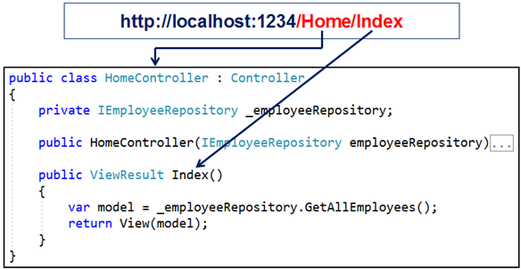
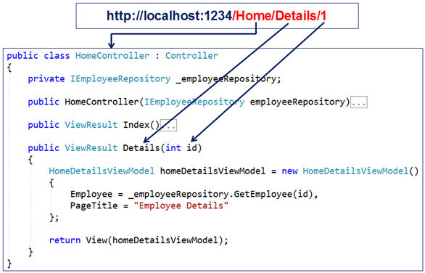
Routing in ASP.NET Core MVC.
There are 2 routing techniques in ASP.NET Core MVC. Conventional Routing and Attribute Routing
When a request from the browser arrives at our application, it is the controller in the MVC design pattern, that handles the incoming http request and responds to the user action. The incoming request URL is mapped to a controller action method. This mapping is done by the routing rules defined in our application.
For example, when a request is issued to /Home/Index, this URL is mapped to the Index() action method in the HomeController class.
Similarly, when a request is issued to /Home/Details/1, this URL is mapped to the Details() action method in the HomeController class. The value 1 in the URL is automatically mapped to the "id" parameter of the Details(int id) action method.
At the moment, we have not explicitly defined any routing rules in our ASP.NET Core MVC application. So the question that comes to our mind is, how is this URL (/Home/Index) mapped to the Index() action method in the HomeController.

Slide 3
Default Route in ASP.NET Core MVC
The following is the code in the Configure() method in Startup.cs file. The code in this method sets up the HTTP request processing pipeline.
Understanding the default route
The default route template "{controller=Home}/{action=Index}/{id?}" maps most URL's that have the following pattern
http://localhost:1234/Employees/Details/1
In the above example
if (env.IsDevelopment())
{
app.UseDeveloperExceptionPage();
}
else
{
app.UseExceptionHandler("/Home/Error");
// The default HSTS value is 30 days. You may want to change this for production scenarios, see https://aka.ms/aspnetcore-hsts.
app.UseHsts();
}
app.UseHttpsRedirection();
app.UseStaticFiles();
app.UseRouting();
app.UseAuthorization();
app.UseEndpoints(endpoints =>
{
endpoints.MapControllerRoute(
name: "default",
pattern: "{controller=Home}/{action=Index}/{id?}");
});
}
Path Segment | Maps to
/Employees | EmployeesController class
/Details | Details(int id) action method
/1 | id parameter of the Details(int id) action method

Slide 4
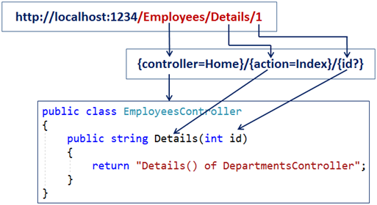
The first URL path segment "/Employees" is mapped to the "EmployeesController". In the URL we do not have to have the word Controller. When MVC finds the word /Employee in the first URL path segment, it appends the word Controller and looks for a class with name EmployeesController.
The second URL path segment "/Details" is mapped to the Details(int id) action method in the EmployeesController.
The third path segment "1" is mapped to the id parameter of the Details(int id) action method. This is done by a process called model binding.
Notice in the following default route template, we have a question mark after the id parameter.
The default route template "{controller=Home}/{action=Index}/{id?}"
The question mark, makes the id parameter in the URL optional. This means both the following URLs will be mapped to the Details() action method of the EmployeesController class.
The value "Home" in {controller=Home} is the default value for the Controller. Similarly the value "Index" in {action=Index} is the default value for the action method.
So with these default values in place, if we navigate to the application root URL like the following. Notice in the URL we do not have the Controller and Action method path segments. So the default values will be used and the request will be mapped to the Index() action method of the HomeController class.
http://localhost:1234
Along the same lines both the following request URL's will also be mapped to the Index() action method of the HomeController class.
http://localhost:1234/Home
http://localhost:1234/Home/Index
/Employees/Details/1
/Employees/Details

Slide 6
Attribute Routing in ASP.NET Core MVC
Consider the following code Startup.cs file. Notice we are using UseMvc()/ services.AddControllersWithViews(); method without passing the default route template as a parameter.
With attribute routing, we use the Route attribute to define our routes. We could apply the Route attribute on the Controller or on the Controller Action Methods.
The Route() attribute is specified 3 times on the Index() action method. With each instance of the Route() attribute we specified a different route template. With these 3 route templates in place, the Index() action method of the HomeController will be executed for any of the following 3 URL paths.
public class HomeController : Controller
{
[Route("")]
[Route("Home")]
[Route("Home/Index")]
public ViewResult Index()
{
return View();
}
}

Slide 7
Attribute Routing Parameters
With conventional routing we can specify route parameter as part of the route template. We can do the same with attribute routing as well. Consider the example below.
Attribute Route Optional Parameters
At the moment, the Details(int id) action method of the HomeController is executed, only if we have a value for the "id" route parameter in the URL(/Home/Details/1).
If the id value is not in the URL, we get 404. For example, URl /Home/Details will not execute the Details(int id) action method. Instead 404 error is displayed.
To make the route parameter "id" optional, simply include a "?" at the end.
public class HomeController : Controller
{
private IEmployeeRepository _employeeRepository;
public HomeController(IEmployeeRepository employeeRepository)
{
_employeeRepository = employeeRepository;
}
[Route("Home/Details/{id}")]
public ViewResult Details(int id)
{
HomeDetailsViewModel homeDetailsViewModel = new HomeDetailsViewModel()
{
Employee = _employeeRepository.GetEmployee(id),
PageTitle = "Employee Details"
};
return View(homeDetailsViewModel);
}
}
public class HomeController : Controller
{
private IEmployeeRepository _employeeRepository;
public HomeController(IEmployeeRepository employeeRepository)
{
_employeeRepository = employeeRepository;
}
// The ? makes id route parameter optional. To make it required remove ?
[Route("Home/Details/{id?}")]
// ? makes id method parameter nullable
public ViewResult Details(int? id)
{
HomeDetailsViewModel homeDetailsViewModel = new HomeDetailsViewModel()
{
// If "id" is null use 1, else use the value passed from the route
Employee = _employeeRepository.GetEmployee(id ?? 1),
PageTitle = "Employee Details"
};
return View(homeDetailsViewModel);
}
}

Slide 8
Controller and Action Method Names
With attribute routing the controller name and action method names play no role in which action is selected. Consider the example below.
public class WelcomeController : Controller
{
[Route("")]
[Route("Home")]
[Route("Home/Index")]
public ViewResult Welcome()
{
return View();
}
}
Since we have specified the route template directly on the action method, Welcome() action in the WelcomeController is executed for all the following 3 URL paths.
/
/Home
/Home/Index

Slide 9
Attribute Routes are Hierarchical
he Route() attribute can be applied on the Controller class as well on the individual actions. To make attribute routing less repetitive, route attributes on the controller are combined with route attributes on the individual action methods.
To make these routes less repetitive, apply the Route() attribute on the HomeController class as shown below.
[Route("Home")]
public class HomeController : Controller
{
private IEmployeeRepository _employeeRepository;
public HomeController(IEmployeeRepository employeeRepository)
{
_employeeRepository = employeeRepository;
}
[Route("")]
[Route("Index")]
public ViewResult Index()
{
var model = _employeeRepository.GetAllEmployees();
return View(model);
}
[Route("Details/{id?}")]
public ViewResult Details(int? id)
{
HomeDetailsViewModel homeDetailsViewModel = new HomeDetailsViewModel()
{
Employee = _employeeRepository.GetEmployee(id ?? 1),
PageTitle = "Employee Details"
};
return View(homeDetailsViewModel);
}
}
The Route template applied on the controller is prepended to the route template applied on the action. However, when we navigate to the root URL (http://localhost:1234), the Index() action method of the HomeController will not be executed. We instead see 404. To address this, include route template that begins with "/" on the Index() action method as shown below.
[Route("/")]
[Route("")]
[Route("Index")]
public ViewResult Index()
{
var model = _employeeRepository.GetAllEmployees();
return View(model);
}

Slide 10
Tokens in Attribute Routing
Attribute routes support token replacement by enclosing a token in square-braces ([ ]). The tokens [controller] and [action] are replaced with the values of the controller name and action name where the route is defined.
This is a very powerful technique because, later if we rename the controller or action name we do not have to change our route templates. The application just works with the new controller and action names.
[Route("[controller]/[action]")]
public class DepartmentsController : Controller
{
public string List()
{
return "List() of DepartmentsController";
}
public string Details()
{
return "Details() of DepartmentsController";
}
}
Conventional Routing vs Attribute Routing
With attribute routing, routes are placed next to the action methods that will actually use them.
Attribute routes offer a bit more flexibility than conventional routes. However, in general, conventional routes are used for controllers that serve HTML pages,
and
attribute routes for controllers that serve REST APIs.
However, there is nothing stopping us from mixing conventional routing with attribute routing in a single application to get a bit more flexibility with routes.

